Slide 1
Unit3: Syntactic Specification of Languages
Syntax analysis

Slide 2
Syntax analysis
Aka Parsing or syntactic analysis
process of analyzing a string of symbols, either in natural language, computer languages or data structures, conforming to the rules of a formal grammar.

Slide 3
Syntax analysis
Detects whether the program is written following the grammar rules and reports syntax errors.
Produces a parse tree from which intermediate code can be generated.

Slide 4
Syntax analysis
token
Lexical
analyzer
Parse
tree
Rest of
front end
Int.
code
Source
program
parser
Request
for token
Symbol
table

Slide 5
Derivations
A series of replacement operations that shows how to derive a string of terminals from the start symbol.
Sequence of steps that, starting with the start symbol, leads to a sentence in the language
Each step replaces one nonterminal with the right-hand side of one production.

Slide 6
Derivations
A series of replacement operations that shows how to derive a string of terminals from the start symbol.

Slide 7
Production
Rules for transforming non-terminal symbols into terminals or other non-terminals
“Nonterminal” ::= terminals and/or nonterminals
Each has lefthand side (LHS) and righthand side (RHS)
Every nonterminal must appear on LHS of at least one production

Slide 8
Rewrite rule
rule of the form A → X where A is a syntactic category label, such as noun phrase or sentence, and X is a sequence of such labels and/or morphemes, expressing the fact that A can be replaced by X in generating the constituent structure of a sentence.

Slide 9
Derivation example
Grammar: E→E+E | E →E | (E) | id
String: id * id + id

Slide 10
Concrete syntax tree
Aka parse tree or Derivation tree
Ordered rooted tree that represents a derivation in the language generated by a context-free grammar
The root represents the starting symbol;
The internal vertices represent nonterminal symbols;
The leaves represent the terminal symbols;
For a production A → w, the vertex representing A will have children vertices that represent each symbol in w.

Slide 11
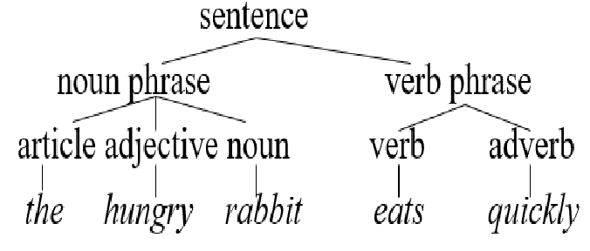
Derivation tree: Example1
Derivation tree for:
the hungry rabbit eats quickly

Slide 12
Derivation tree: Example1
Given the rules:
E -> T + T | T - T | T
T -> F * F | F / F | F
F -> C | V | (E)
V -> X | Y | Z
C -> D{D}
D-> "0" | "1" | "2" | "3" | "4" | "5" | "6" | "7" | "8" | "9";
And the input string i+i*i

Slide 13
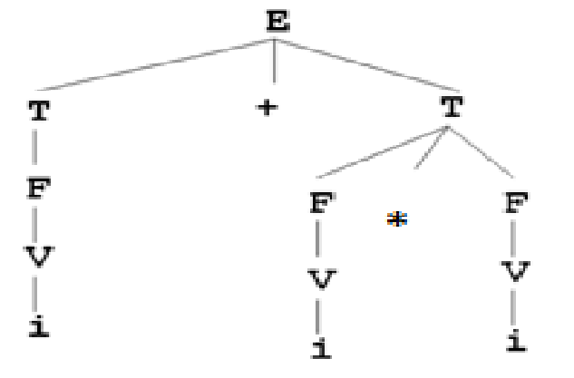
Derivation tree: Example1 (Cont.)

Slide 14
Abstract syntax tree (AST)
Aka syntax tree
Tree representation of the abstract syntactic structure of source code written in a programming language.
Each node of the tree denotes a construct occurring in the source code.

Slide 15
AST (Cont.)
Does not represent every detail that appears in the real syntax.
Grouping parentheses are implicit in the tree structure
Syntactic construct such as an if-condition-then expression may be denoted by a single node with two branches.

Slide 16
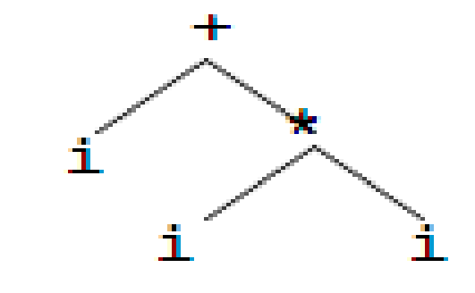
AST: Example
Given the string: i+i*i
Built its AST

